Slide 1


PCA Analysis on Iris Dataset
By Shourish Kothawale & Rafael Prignano

Slide 2
Introduction
Named after the goddess of the rainbow, Iris.
Created by Ronald Fisher in 1936 that soon became an essential foundation for data visualization and science
Famous dataset for being beginner friendly
Contains sepal length and width, petal length & width (measured in cm)
150 observations of three species
Setosa, Versicolor, Virginic

Slide 3
Problem Statement
Main Problem: High correlations and redundancy among numerous variables can produce unclear analysis.
Solution: Principal Component Analysis (PCA): Reduces correlated numeric variables into a smaller, uncorrelated set called multicollinearity that will enable accurate statistical analysis.
Project Objective: Apply Principal Component Analysis to the iris dataset and retain key patterns present in the dataset and illustrate the visualizations and distinguish special characteristics.

Slide 4
Exploratory Data Analysis
Scatterplots:
Visualize relationships between pairs of variables.
Reveal trends, correlations, clusters, and outliers.
Correlation Types:
Positive: Both variables increase together.
Negative: One variable increases as the other decreases.
No Correlation: No apparent relationship.
Species Differentiation:
Points are colored/shaped by species (Setosa, Versicolor, Virginica).
Highlights variations in relationships across species.
Purpose:
Provides preliminary insights into patterns and relationships.
Serves as a foundation for statistical analysis

Slide 5
Bivariate Scatterplot Matrix
Strongest Positive Relationships:
PetalLengthCm vs. PetalWidthCm (0.96):
Extremely strong positive correlation; almost perfectly related.
SepalLengthCm vs. PetalLengthCm (0.87):
Strong positive relationship.
SepalLengthCm vs. PetalWidthCm (0.82):
Strong positive correlation, but slightly weaker than the above.
Weakest Relationship:
SepalLengthCm vs. SepalWidthCm (-0.11):
Virtually no linear relationship; correlation close to zero.
Negative Correlations:
SepalWidthCm vs. PetalLengthCm (-0.42):
Weak to moderate negative trend.
SepalWidthCm vs. PetalWidthCm (-0.36):
Weak to moderate negative trend.

Slide 6
Histograms
SepalLengthCm:
Distribution: Roughly normal, with a central peak and minimal right skew
Values are centered with a few higher extremes
SepalWidthCm:
Distribution: Slightly bimodal, indicating two subgroups
Potentially linked to species or categories
PetalLengthCm:
Distribution: Clear peak at the lower range, skewed.
Most values are low with extreme outliers
PetalWidthCm:
Distribution: Skewed to the right and unimodal
Most flowers have smaller petal widths with fewert larger outliers

Slide 7
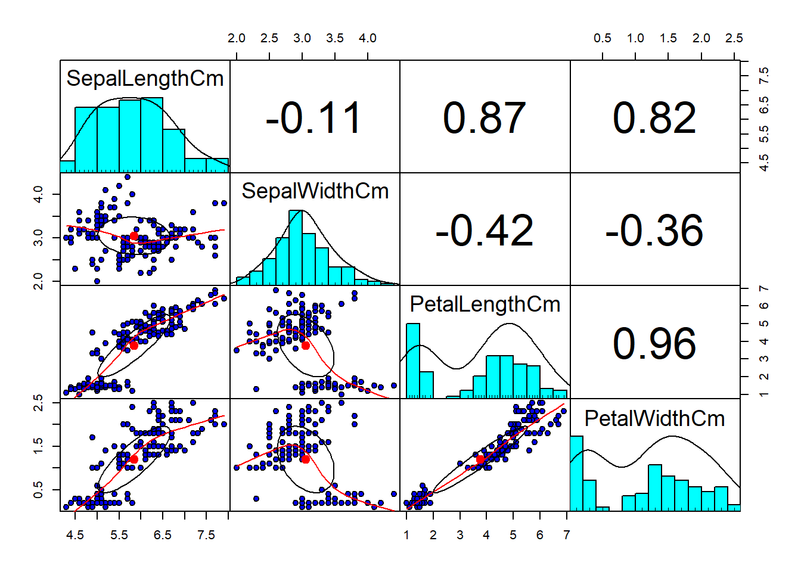

Slide 8
Principal Component Analysis Overview
PCA: Dimensionality reduction technique that can transform correlated variables and make them uncorrelated called principal components.
PCA helps create clearer visualization and reveal the underlying structure behind data.
2 steps for PCA:
PC1: Captures maximum variance in the dataset
PC2: Captures remaining variance orthogonal to PC1.

Slide 9
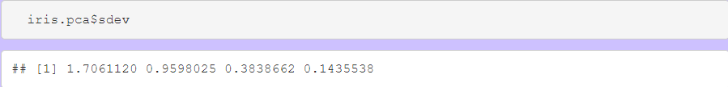
Standard Deviation and Center
* The sdev attribute of a prcomp object shows each PC's standard deviation, reflecting its variability. PCA maximizes sdev to capture the dataset's variability with fewer PCs.
* The center attribute of a prcomp object shows the mean subtracted for each PC, helping to understand each feature's mean and calculate variability.

Slide 10
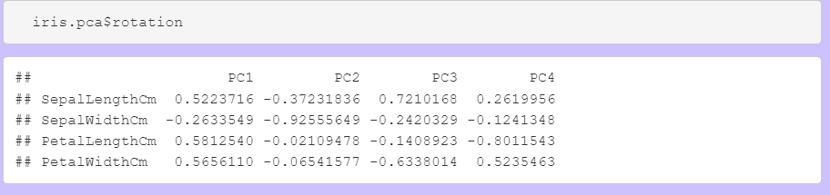
Rotation
Rotation Attribute: Key for fitting PCs to data points.
Eigenvectors: Represents directions of PCs as unit vectors.
Orthogonality: Eigenvectors are uncorrelated (zero covariance).
Selection: PCs with highest variability are prioritized.

Slide 11
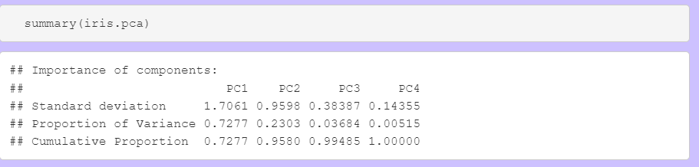
Summary of PCA Object
PC Summary: Critical for eliminating unneeded PCs in PCA analysis.
Key Metric: Proportion of Variance shows each PC's influence.
Top Contributors:
PC1: Accounts for 72.77% of variability (most significant).
PC2: Contributes 23.03% (second most variability).
Cumulative Variance:
PC1 + PC2 together explain 95.80% of the total variability.
Only 4.20% variability is lost.
Conclusion: Dimensional reduction to two PCs is sufficient.

Slide 12
Orthogonality
Orthogonality in PCA: Ensures PCs are linearly independent.
Key Test: Perform correlation analysis; orthogonal PCs have zero correlation.
Purpose: Avoid redundancy and maximize variability capture.
Non-Orthogonal Vectors: Can be formed by basis vectors, reducing variability representation.
Visualization: Bi-plots help confirm PCA produces linearly independent components.

Slide 13
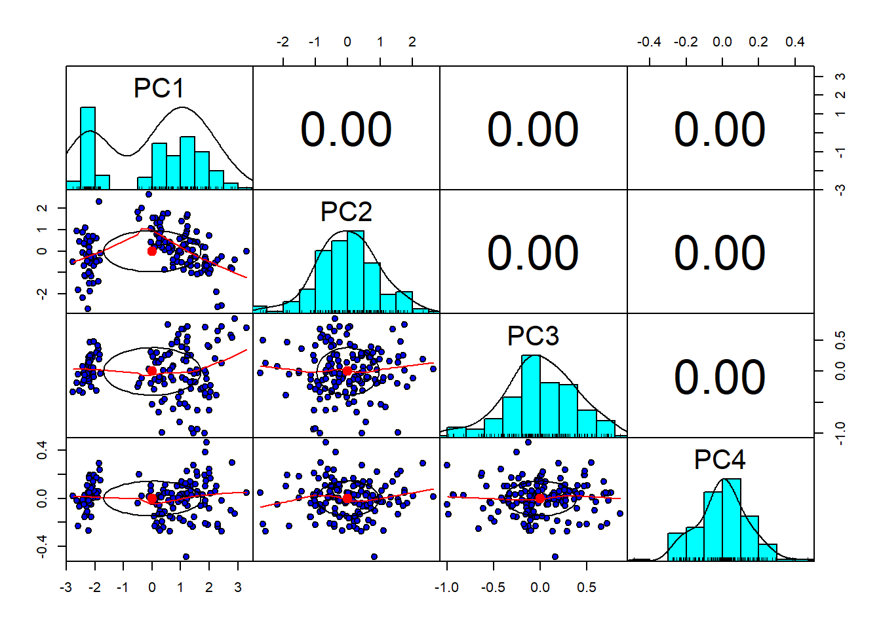

Slide 14
Biplot
Biplot Overview: Visualizes observations and variables in 2D using principal components.
Data Points: Represent individual samples; positions indicate similarity or differences.
Arrows: Show variable contributions to PCs:
Longer arrows: Strong influence.
Shorter arrows: Weak influence.
Angles Between Arrows:
Small angles: Strong positive correlation.
Wide angles or opposite directions: Weak or negative correlation.
Purpose: Highlights patterns (e.g., clusters) and shows variable influences.
Benefit: Simplifies complex data for easy interpretation.

Slide 15
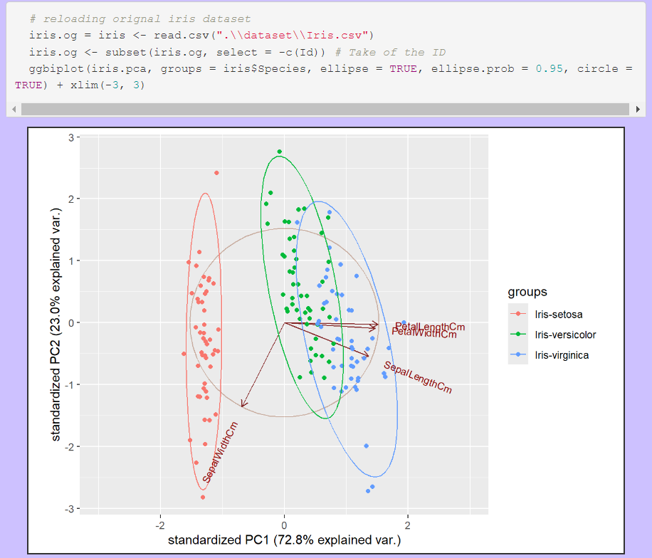

Slide 16
Biplot Analysis Summary
Color-Coded Points & Species Groups:
Red: Iris-setosa (distinct, well-separated cluster).
Green: Iris-versicolor (overlaps with Iris-virginica).
Blue: Iris-virginica (overlaps with Iris-versicolor).
Variable Contributions (Arrows):
PetalLengthCm & PetalWidthCm:
Long arrows aligned with PC1, indicating strong influence and high correlation.
SepalLengthCm:
Contributes to PC1 but less strongly than petal dimensions.
SepalWidthCm:
Points toward PC2, showing less correlation with other variables.

Slide 17
Biplot Analysis Summary cont.
Ellipses (Confidence Regions):
Iris-setosa: Tight and distinct, indicating clear separation.
Iris-versicolor & Iris-virginica: Overlapping, showing similarities and reduced separability.
Summary Insights:
Petal dimensions are key for species differentiation.
Sepal width primarily influences PC2.
Iris-setosa is unique, while Iris-versicolor and Iris-virginica share overlapping traits

Slide 18
Advanced Application
Purpose: Predict categorical outcomes using principal components (PCs) as predictors.
Role of PCA:
Reduces dimensionality by capturing the most significant variance in the data.
PCs (linear combinations of original features) serve as independent variables.
Multinomial Logistic Regression:
Models log-odds of each category relative to a reference category.
Classifies data into multiple categories based on PCs.
Advantages:
Simplifies the model by reducing dimensions.
Improves performance by focusing on key variance sources in the dataset.

Slide 19
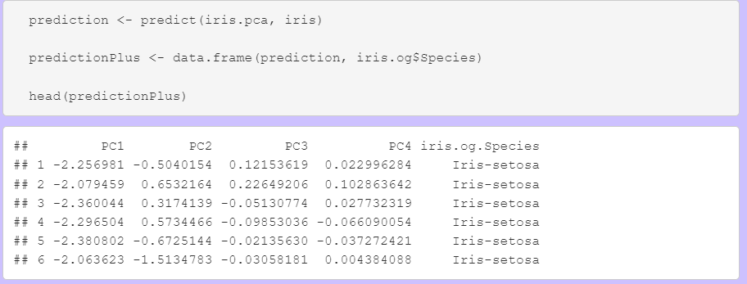
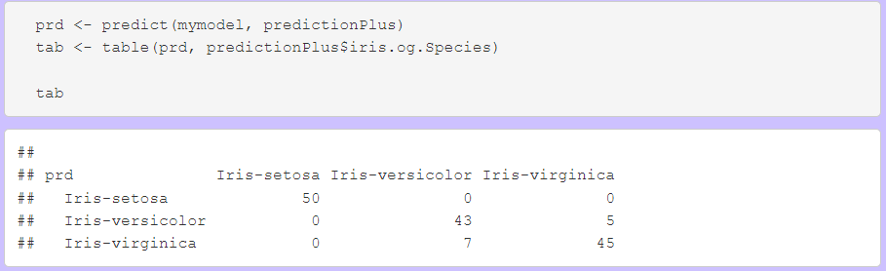

Slide 20
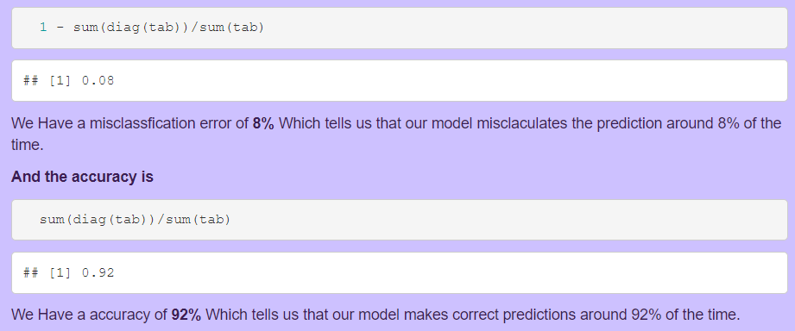

Slide 21
Advantages and Disadvantages
Strengths of PCA:
Dimensional Reduction: Reduces variables while retaining most of the variance.
Reduced Multicollinearity: Converts correlated variables into uncorrelated components.
In-Depth Filtering: Highlights key variances and filters out noise.
Enhanced Visualization: Reduces high-dimensional data to two or three dimensions for better interpretation.
Challenges of PCA:
Scaling Sensitivity: Improper scaling can lead to inaccurate results.
Variance Limitation: Focuses heavily on variance, which may not capture all relevant patterns.
Explainability Loss: PCs are combinations of original variables, making interpretation less intuitive.

Slide 22
Conclusion
Applications of PCA:
Visualization: Simplifies complex datasets for better clarity.
Exploratory Data Analysis: Identifies key patterns and relationships in data.
Feature Redundancy Reduction: Improves performance by removing redundant features while preserving critical information.
Effectiveness:
PCA is a powerful tool for reducing redundant data while maintaining essential variance, despite its limitations in explainability and scaling sensitivity.

